Slide 1


Trends and climate of US Breweries
A report prepared by Tajar, Inc.
Rajat Chandna, Andy Ho, An Nguyen, Jodi Pafford, and Tori Wheelis

Slide 2
The TAJAR, Inc Team:
Tori Wheelis
Andy Ho
Jodi Pafford
An Nguyen
Rajat Chandna

Slide 3
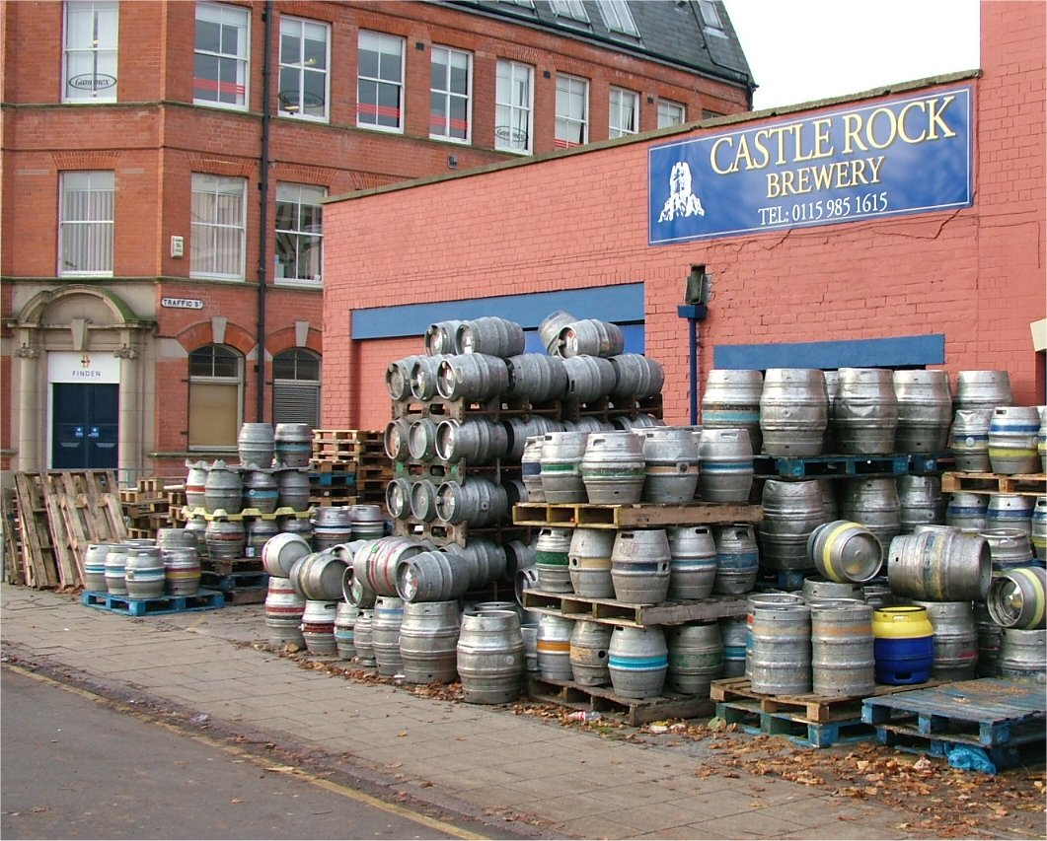
The Brewery File:
Original Has 558 Brewery Records
Importance of Data Integrity
Correcting records without sacrificing Data Set integrity
Double Sweep to Clean
Method of starting with State, City, Brewery Name & back to State
Nothing Falls through the Crack
custom discovery loop to identify potential data issues
This Photo by Unknown Author is licensed under CC BY-SA
Notes:
<ANDY>
At initial glance, the 558 records in the brewery file seemed to have a few duplicates. But one duplicate led to more discoveries and it became evident it required more than one data scientist’s eyes. Rajat and I was tasked to clean up the mess for the merge with the Beers file. Our strategy and approach is as follows:
Cleaning while keeping data integrity
Double Sweep to Clean any misspellings, punctuations, duplicates, and inaccuracies.
Creating a custom discovery loop so nothing fell through the crack.
To explain in more detail, Rajat will take us through the approach and results.
<RAJAT>
Thank you Andy. To echo what Andy said, our goal was to clean without removing any records with issues. We felt it was important to have all the brewery names, city, and state cleaned and prepped for the masterfile merge.
[Give explanation of the double sweep method and why we chose this approach]
[Give explanaiotn of the custom discovery loop written to capture the first 3/last 3 letters and why we were deliberate in creating this code]
3. [Provide a few examples of City correction and Brewery correction.]

Slide 4
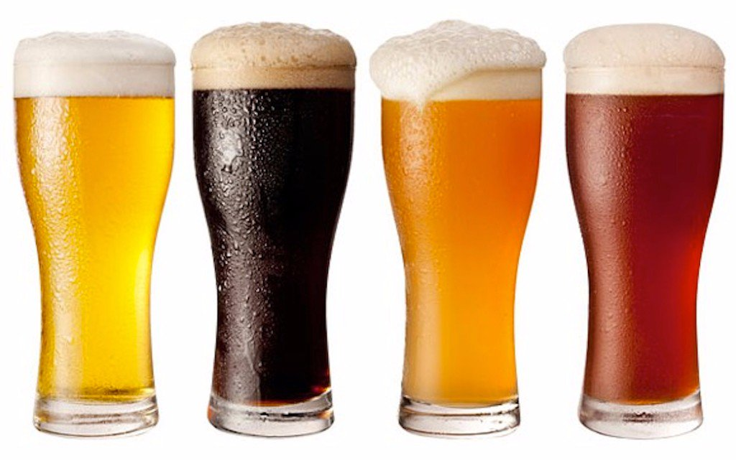
The Beers File:
Original file has 2,410 lines of data
Removal of obvious duplicates
Search beginning and ending strings
Kept beers with different ending strings (i.e. 2010, 2008)
Prepare File for Merging
Final File, CleanedBeerData, used to merge, contains 2,366 different types of beer
This Photo by Unknown Author is licensed under CC BY-NC-ND

Slide 5
Organization and Structure of the masterfile
Summary:
2366 Unique Beers
382 Cities
50 States (plus 1 District)
Variables:
10 Variables
Notes:
<ANDY>
Thanks Tori. So after merging the brewery and beers into one master file, we find ourselves with 2,366 unique beers, spread throughout 382 cities, and 50 States (plus 1 District of Columbia) -- and 10 variables (aka description) for each of the beers. The variables are as follows:
Brewery_ID
Beer_ID
Beer_name
ABV – Alcohol by Volume – Standard measure of how much alcohol (ethanol) is contained in a given volume of an alcoholic beverage.
IBU – International Bitterness Units - Rather than telling us how much alcohol there is, IBU measures the bitterness from hops in a beer on a scale of 0 to 100
Style – Such as IPA, Pilsner, Lager, Pale Ale, etc…
Ounces – Standard capacity of the beer
Brewery_Name
City
State
We’ve taken the liberty of highlighting the first 6 and the last 6 records to verify the total count and variables. Please note the file is in ascending order by Brewery_ID.

Slide 6
Further Discoveries: Any missing Values?
STYLE: 5
ABV: 62
IBU: 997
Beer Name
Brewery Name
Ounces
City
State
Notes:
<ANDY>
There are some values missing but for the most part, limited to three variables:
Style
ABV
IBU
As you can see, Style has 5, ABV has 62,and IBU has 997. Only about 2.4% of the beers we have are missing information on alcohol by volume and 42% of the beers are missing information about their bitterness, using the International Bitterness Unit Scale. This will be taken into account as we answer other questions regarding ABV and IBU comparisons. Regardless, this still leaves majority of our beers with complete information. Most importantly, the Brewery and Beer Names, Ounces, City and State have no values missing.

Slide 7
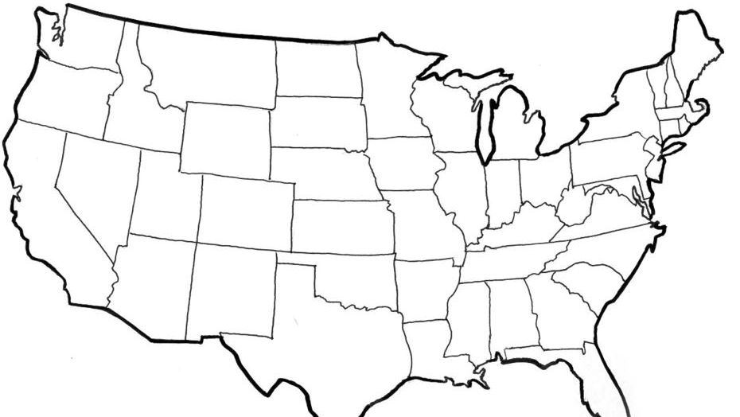
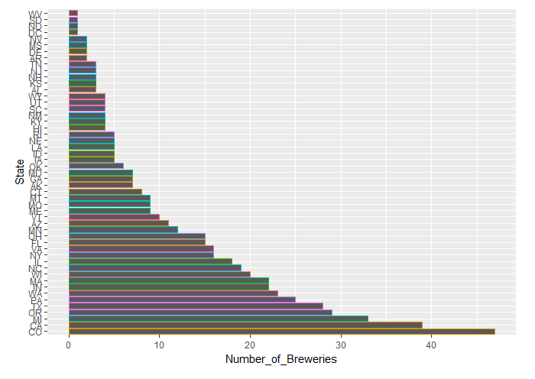
US Brewery Locations
This Photo by Unknown Author is licensed under CC BY-SA

Slide 8
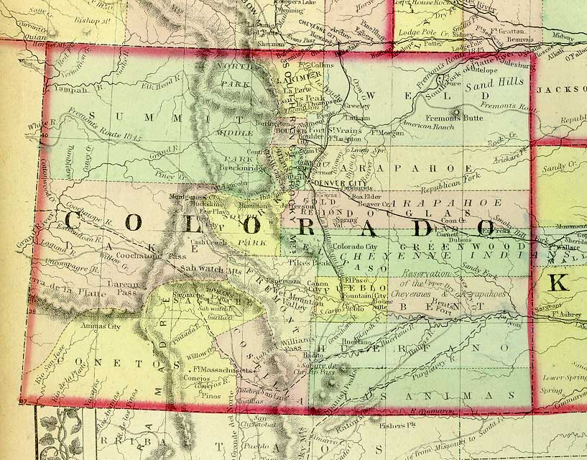
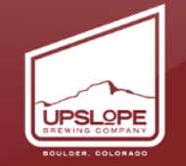
Maximum ABV
12.5% ABV
This Photo by Unknown Author is licensed under CC BY-NC-SA

Slide 9
Other Notable Information about ABV
Bottom 6 Max ABV’s per State
Delaware- 5.5%
Arkansas- 6.1%
Tennessee- 6.2%
New Hampshire- 6.5%
North Dakota- 6.7%
West Virginia- 6.7%
Top 6 Max ABV’s Per State
Colorado- 12.8%
Kentucky- 12.5%
Indiana- 12.0%
New York- 10%
Wisconsin- 9.9%
Texas- 9.9%

Slide 10
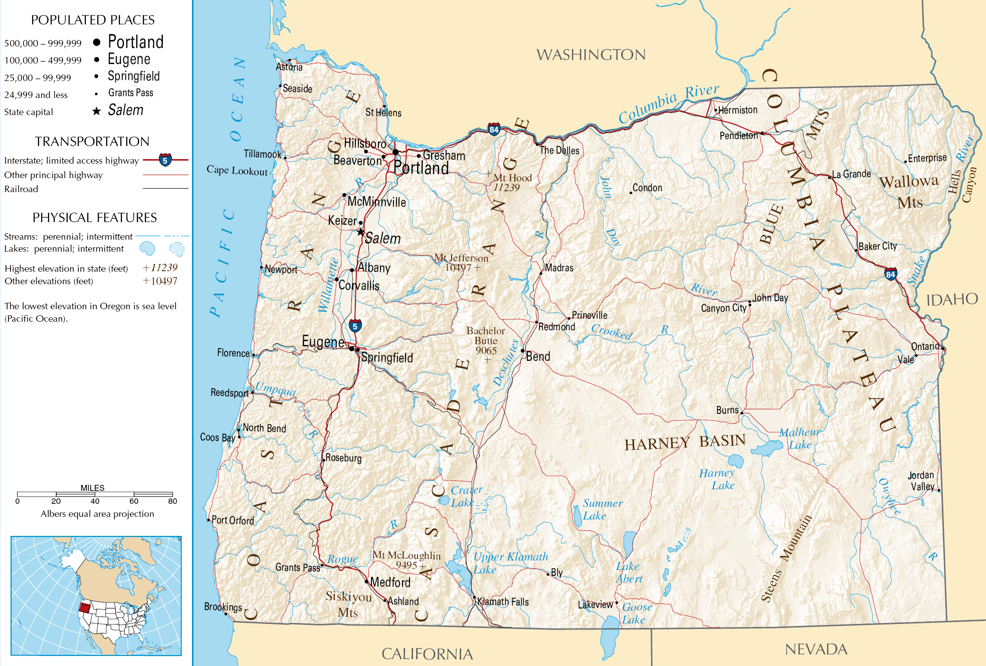

Most Bitter (IBU)
138 IBU
This Photo by Unknown Author is licensed under CC BY-SA

Slide 11
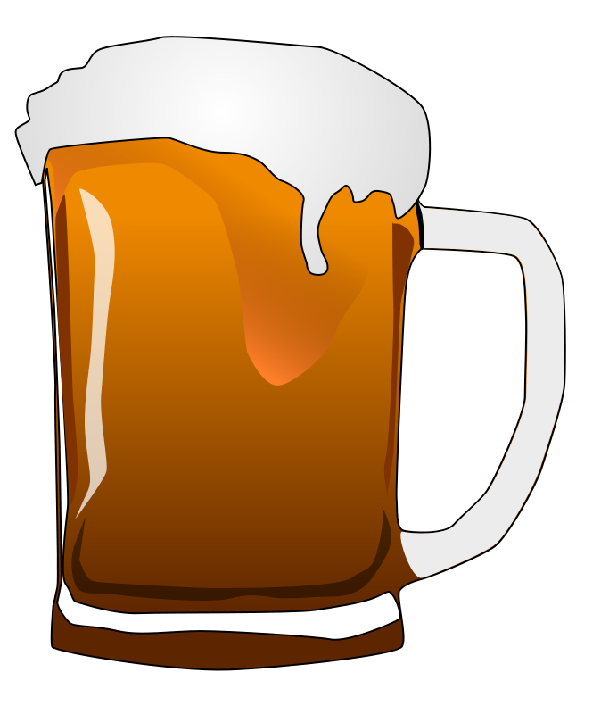
Median Alcohol Content & International Bitterness Units
Top 5 Highest Median IBU’s Per State:
Maine (61)
West Virginia (57.5)
Florida & Georgia (55)
Oregon (54)
Lowest 5 Median IBU’s Per State:
Wisconsin and Kansas (20)
Arizona (20.5)
Wyoming (21)
Hawaii (23)

Slide 12
Median Alcohol Content & International Bitterness Units
Wide range of ABV’s
5.5% (Delaware) to 12.8% (Colorado)
After New York, the next 13 state’s ABV’s are 9.9%
A sizable portion of the beers in the dataset have an ABV at or around 9-10%
The median of the median ABV’s is 9%
The median of the median ABV’s in each state is 9%
The third quartile of the median ABV’s in each state is 9.9%

Slide 13
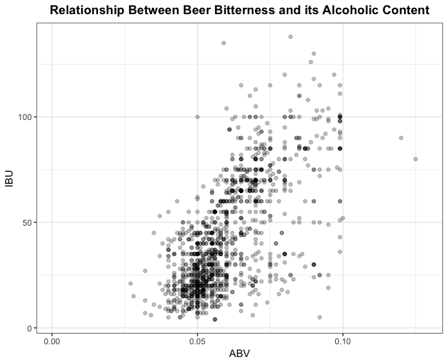
IBU vs ABV Relationship?

Slide 14
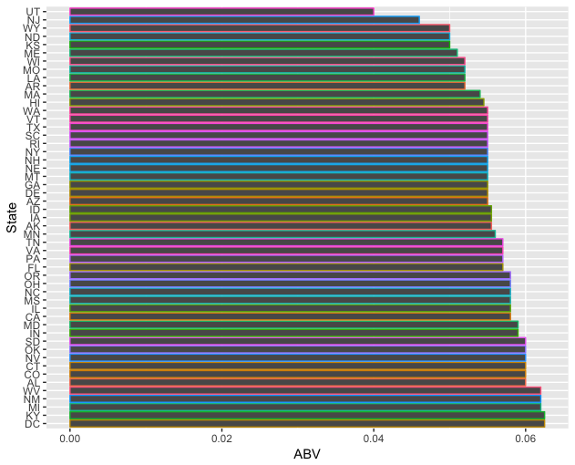
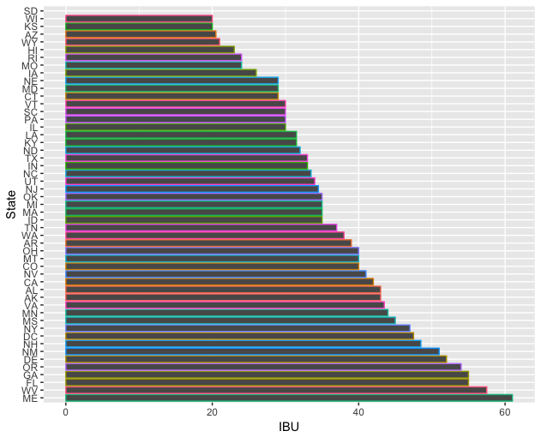
Median IBU and ABV’s per state

Slide 15

Conclusions
Tennessee
Arkansas
Missouri
South Carolina
Prime Location
Between 5% and 6.5 %
ABV
Between 30 and 50
IBU

Slide 16

Questions?

Slide 17
Thank You for allowing us to partner with you

